Slide 1





















SHAPE SHOP
The Shape Puzzle Challenge

Slide 2





ROUND 0NE

Slide 3




ROUND TWO

Slide 4

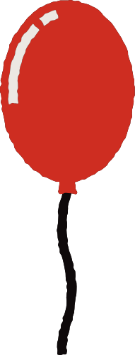
ROUND THREE

Slide 5





ROUND FOUR

Slide 6


ROUND FIVE

Slide 7


ROUND SIX

Slide 8
ROUND SEVEN
?

Slide 9
ROUND EIGHT
?

Slide 10
ANSWER KEY
Round 1: Match the objects to their shadows.
Round 2: Stack the objects according to the model on the left.
Round 3: Match the objects according to their colors.(align option)
Round 4: Assemble the objects to create the robot.
Round 5: Arrange the objects according to height.
Round 6: Recolor the shapes to match the objects on the left.
Round 7 and 8: Complete the pattern.

Slide 11


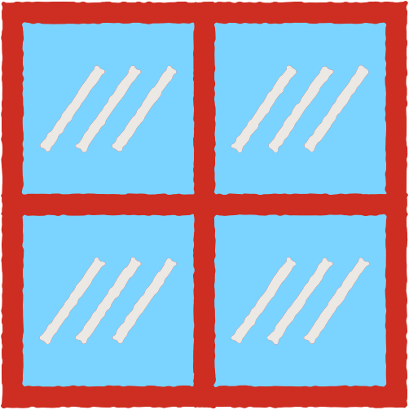
RESOURCES PAGE

